Slide 1
PHP Connect to MySQL Server

Slide 2
What is MySQL
MySQL is one of the most popular relational database system being used on the Web today. It is freely available and easy to install.

Slide 3
Ways of Connecting to MySQL through PHP
PHP offers two different ways to connect to MySQL server:
MySQLi (Improved MySQL)
PDO (PHP Data Objects) extensions.
Note: The PHP's MySQLi extension provides both speed and feature benefits over the PDO extension, so it could be a better choice for MySQL-specific projects.

Slide 4
Connecting to MySQL Database Server
In PHP you can easily do this using the mysqli_connect() function.
All communication between PHP and the MySQL database server takes place through this connection.

Slide 5
Connection
Syntax: MySQLi, Procedural way
$link = mysqli_connect("hostname", "username", "password", "database");
Syntax: MySQLi, Object Oriented way
$mysqli = new mysqli("hostname", "username", "password", "database");
Syntax: PHP Data Objects (PDO) way
$pdo =new PDO("mysql:host=hostname;dbname=database", "username", "password");

Slide 6
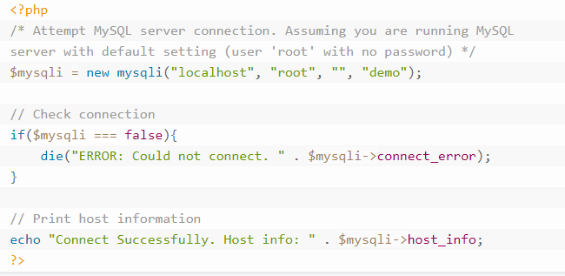
Connecting to MySQL Database Server
The following example shows how to connect to MySQL database server using MySQLi (Procedural)

Slide 7
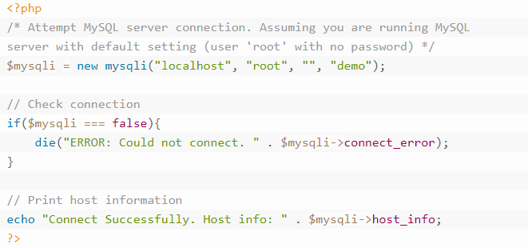
Connecting to MySQL Database Server
The following example shows how to connect to MySQL database server using MySQLi(Object Oriented)

Slide 8
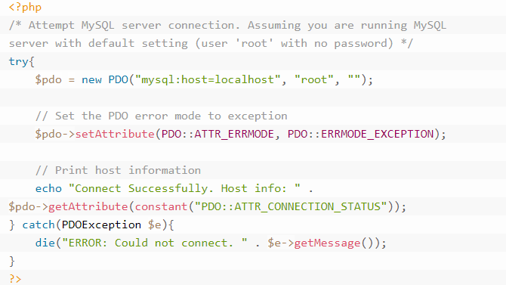
Connecting to MySQL Database Server
The following example shows how to connect to MySQL database server using PDO extension.

Slide 9
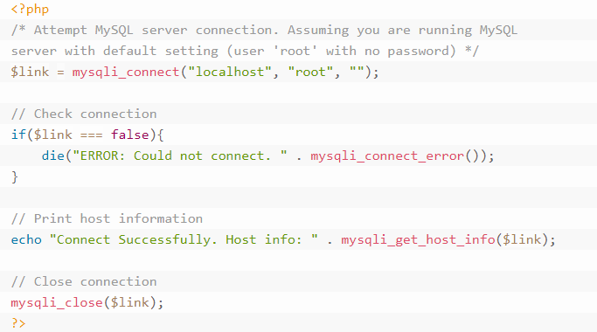
Closing the MySQL Database Server Connection
Procedural

Slide 10
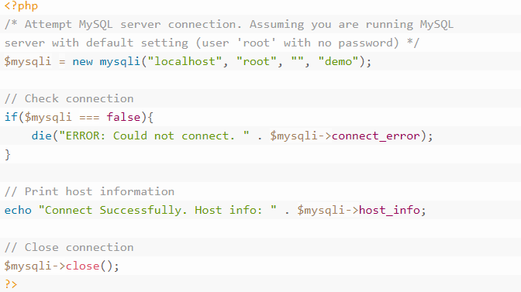
Object Oriented

Slide 11
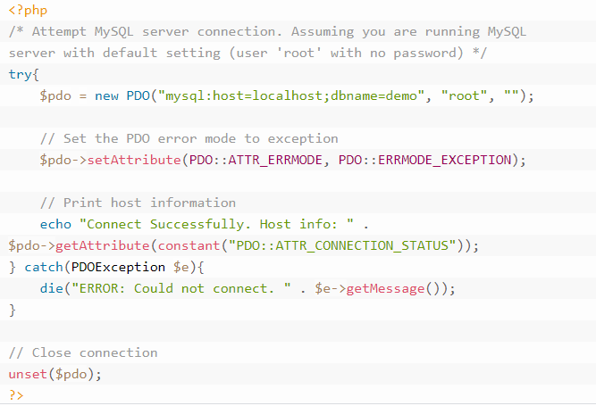
PDO

